Slide 1
Ch5 REVIEW
Radicals and Root Functions

Slide 2
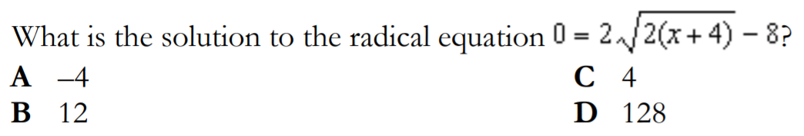

Slide 3
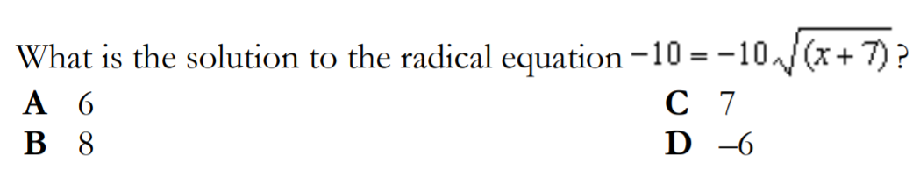

Slide 4
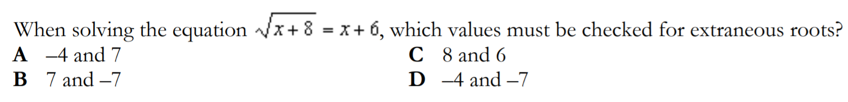

Slide 5
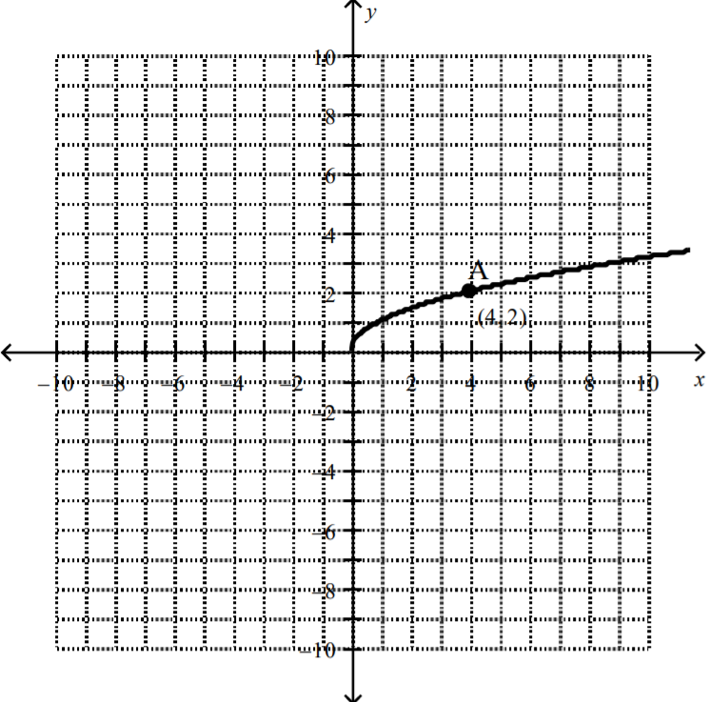
Given the graph on the right and that point A(4,2) is on the root function, which of the following is an equation for this graph?

Slide 6
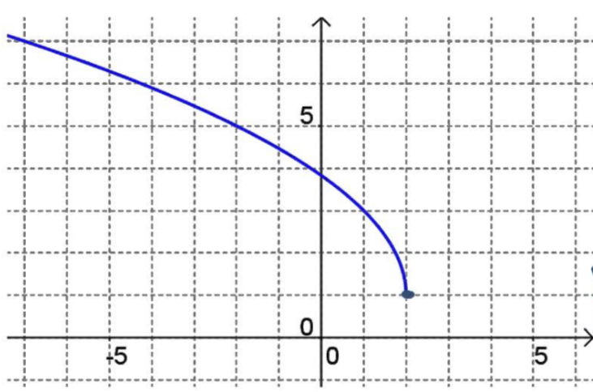
Given the graph on the right, which of the following is an equation for this graph?

Slide 7
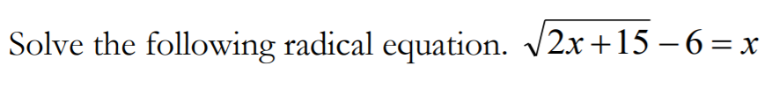

Slide 8



Solve the following:

Slide 9
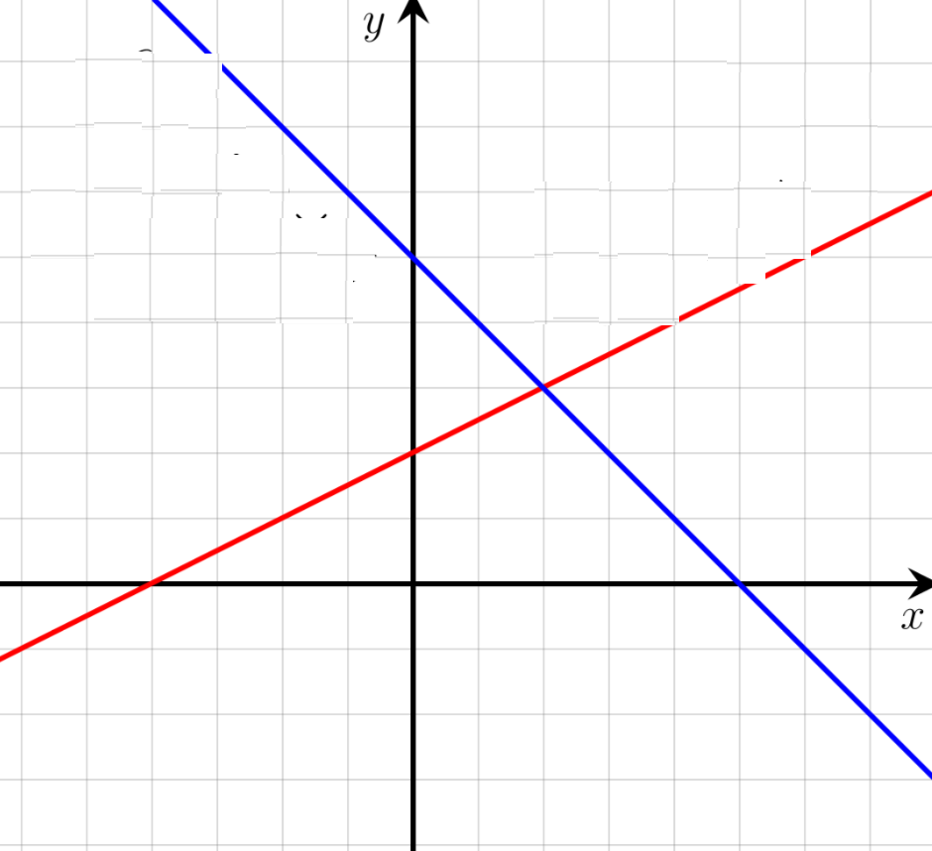
What are the equations of the two lines given in the diagram to the right?

Slide 10
Which of the following will equations will have no solutions?

Slide 11
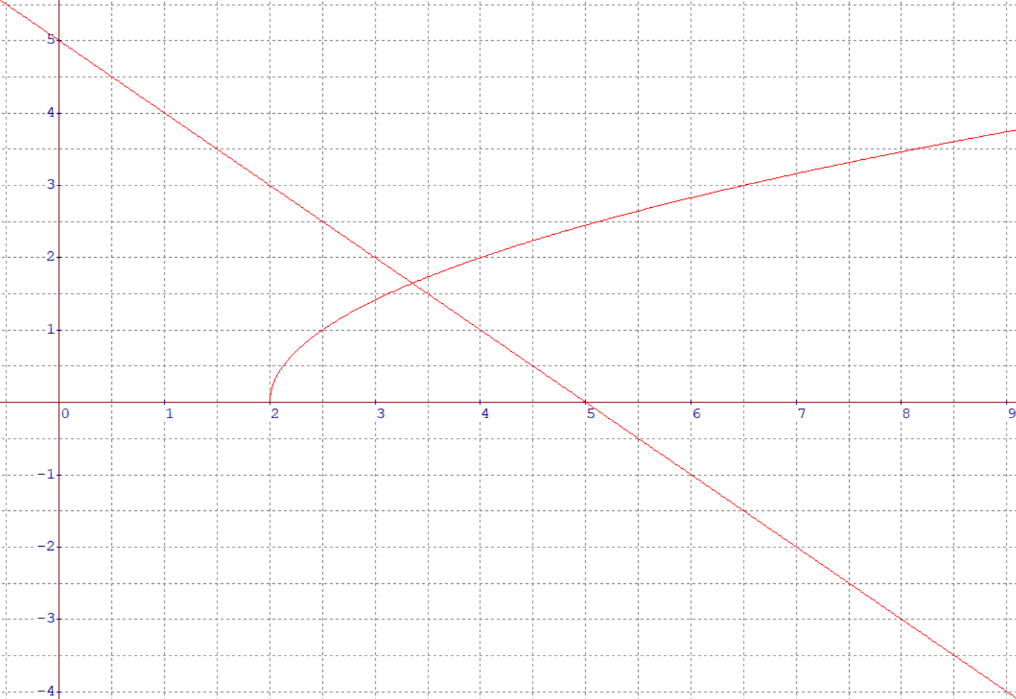
Which of the following equations is reflected in the graph to the right?

Slide 12
When given the following graph, which of the following is the correct conclusion?
There is only one correct solution around x=3.4 and no extraneous roots
There are two extraneous roots at x=3.4 and around x=8.7
When you solve for the values of “x”, the extraneous root will be the smaller value
There is one correct answer and one extraneous root with a larger value
You can not tell how many solutions and extraneous root by looking at the graphs

Slide 13
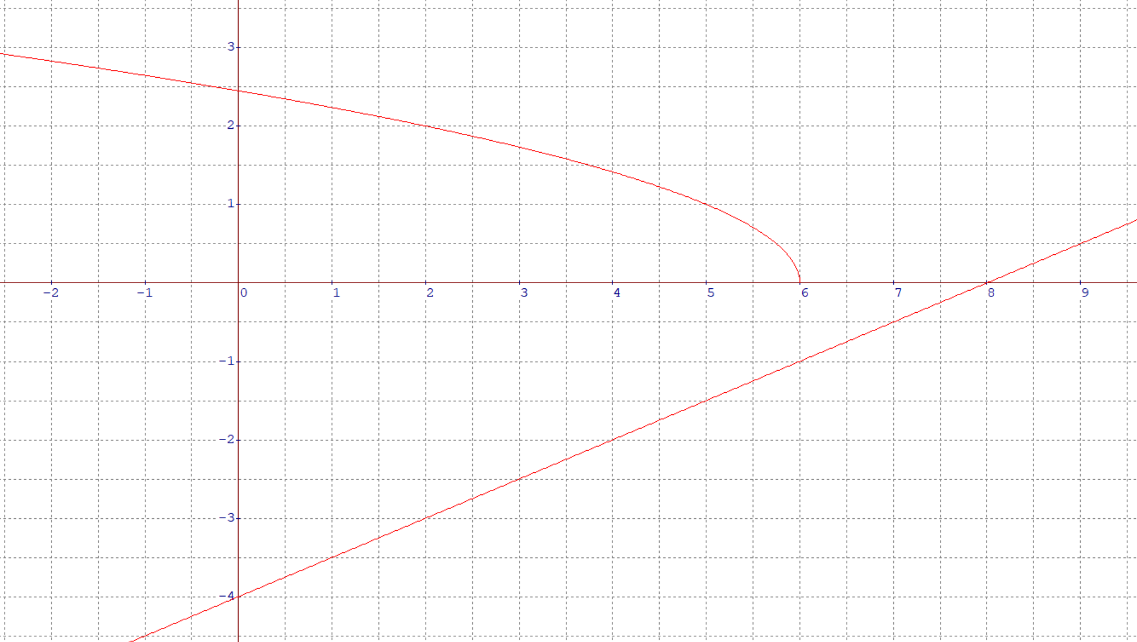
Which of the following equations is reflected in the graph to the right?

Slide 14
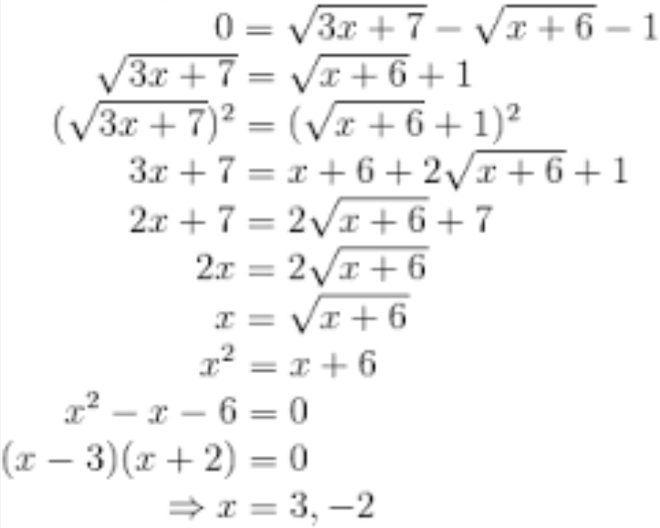
The following work was shown for solving an equation with two radicals. Which of the following is the correct conclusion?
x=3 is an extraneous root so x=-2 is the correct answer
X=-2 is extraneous because “x” can’t be a negative value
Both answers are correct and not extraneous
X=3 is the only correct answer
X=-2 is an extraneous root because both sides will not be equal when plugged into the 2nd line
There is a mistake in one of the steps and both answers are invalid

Slide 15
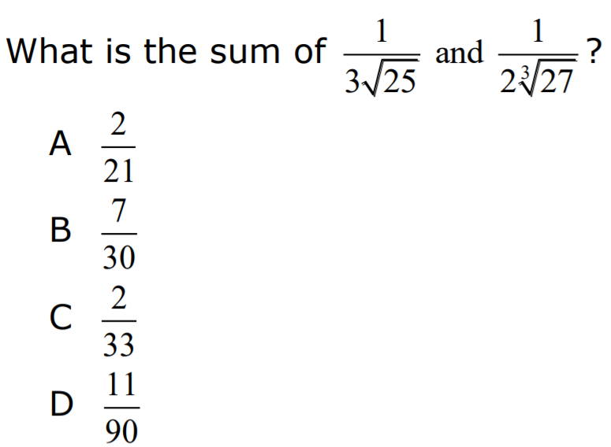

Slide 16
